Slide 1
Introduction to R
Mr. Shrikrishna Anand Narvekar
Assitant Professor
Computer Engineering department
Agnel Institute of Technology and Design

Slide 2
Content
What is R ?
R is better than Excel?
Drawbacks of Excel
History of R
Nuts and Bolts of R
Installation guide
R studio description

Slide 3
What is R
R is a programming language and software environment specifically designed for statistical computing and graphics.
It is widely used among statisticians, data analysts, and data scientists for data analysis and visualization.

Slide 4
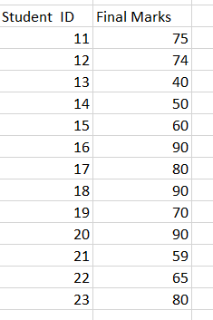
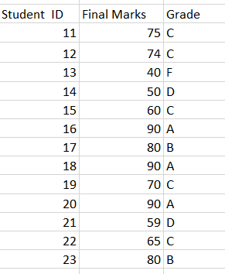
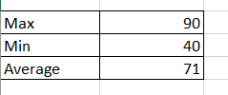
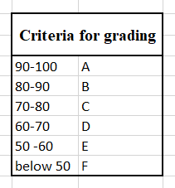
R is better than Excel?
Final Data based on the grading
Basic Analysis

Slide 5
Drawbacks of Excel
Excel has some limitation in size of that it can handle. (around 1 million rows)
Memory allocation is not dynamic
If Excel is utilized to 60 % then you will see lot of lag
Excel as a tool is not free as it comes with Microsoft office
Resolving errors in excel is difficult
It cannot go as deep as R can go in terms of statistics

Slide 6
History of R
The R language originated as an implementation of the S programming language, which was developed at Bell Laboratories .
R was created in the early 1990s by Ross Ihaka and Robert Gentleman at the University of Auckland, New Zealand, as a free software environment inspired by S. The first official release of
The R Core Team, a global group of volunteer developers, maintains R, which is released under the GNU General Public License (GPL), making it free and open-source.R was in February 2000.
Over the years, R has gained popularity in academia and industries like finance and bioinformatics. The Comprehensive R Archive Network (CRAN) offers thousands of packages to extend R's capabilities.

Slide 7
Nuts and Bolts of R
R is a programming language and environment developed for statistical analysis
Graphical capabilities of R are outstanding that surpasses other statistical tools.
R is free and open source. It is licensed under GNU, General Public License
Anyone can provide a new packages(which is actually disturbs stability of software)
R is cross platform and runs on any OS
R plays well with other tools, importing data from CSV, SPSS,SAS, or directly from Microsoft excel , Microsoft access, Oracle, MySQL, SQLite
Notes:
R is a programming language and environment developed for statistical analysis by practising statisticians and researchers. It reflects well on a very competent community of computational statisticians.
The graphical capabilities of R are outstanding, providing a fully programmable graphics language that surpasses most other statistical and graphical packages.
R is free and open source software, allowing anyone to use and, importantly, to modify it. R is licensed under the GNU General Public License, with copyright held by The R Foundation for Statistical Computing.
R has no license restrictions (other than ensuring our freedom to use it at our own discretion), and so we can run it anywhere and at any time.
Anyone can provide new packages, and the wealth of quality packages available for R is a testament to this approach to software development and sharing.
R has over 4800 packages available from multiple repositories specializing in topics like econometrics, data mining, spatial analysis, and bio-informatics.
R is cross-platform. R runs on many operating systems and different hardware. It is popularly used on GNU/Linux, Macintosh, and Microsoft Windows, running on both 32 and 64 bit processors.
R plays well with many other tools, importing data, for example, from CSV files, SAS, and SPSS, or directly from Microsoft Excel, Microsoft Access, Oracle, MySQL, and SQLite.
It can also produce graphics output in PDF, JPG, PNG, and SVG formats, and table output for LATEX and HTML.

Slide 8
Design of R system
The primary R system is available from the Comprehensive R Archive Network, also known as CRAN. CRAN also hosts many add-on packages that can be used to extend the functionality of R.
The R system is divided into 2 conceptual parts:
The “base” R system that you download from CRAN: Linux Windows Mac Source Code
Everything else.

Slide 9
Design of R system
R functionality is divided into a number of packages.
The “base” R system contains, among other things the base package which is required to run R and contains most fundamental functions
The other packages in the “base” system includes utils, stats, datasets, graphics, grDevices, grid, methods, tools etc
We will be using R studio

Slide 10
What is R studio?
RStudio is an integrated development environment (IDE) for R, providing a user-friendly interface to interact with the R programming language.
It is considered as useless without base R because of following reasons
Dependency on R
Execution of R code
Package management
Scripting and interactive work
Graphical capabilities

Slide 11
Installation of R and R studio
To Install Base R refer the link below
https://cran.r-project.org/
To Install R studio refer the link given below
https://posit.co/download/rstudio-desktop/

Slide 12
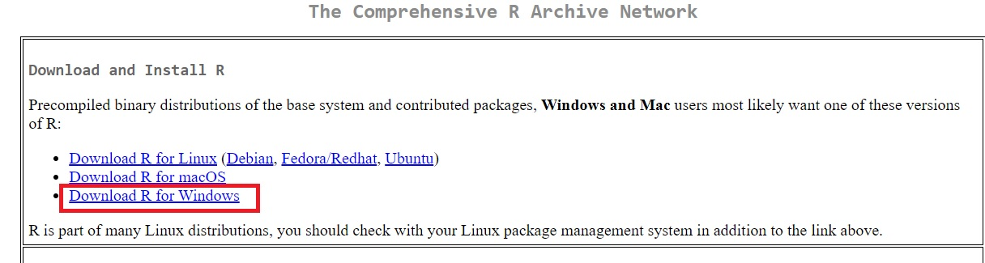
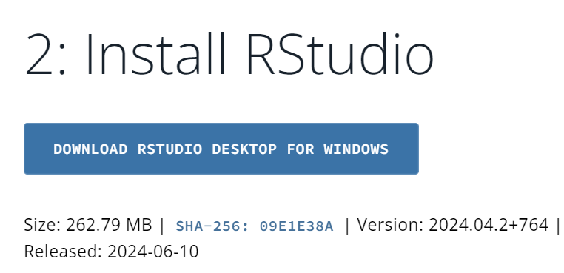

Slide 13
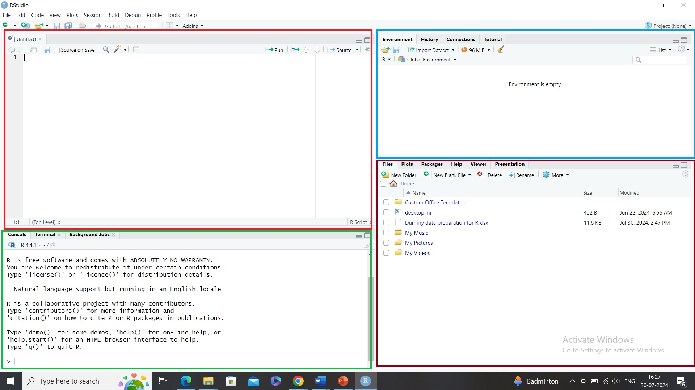
R studio
Environment pane
Script
Plot Pane/
Graphics Pane
Console
Notes:
1. Scripts: This is where you write and edit your R scripts, R Markdown files, or Notebooks.
Features:
You can write multiple lines of R code.
Click the Run button or press Ctrl + Enter to execute selected lines in the console.
Tabs allow you to work with multiple files simultaneously.
Supports syntax highlighting, code completion, and commenting.
2. 2. Console Pane (Bottom-Left)
Purpose:
This is the command-line interface of R. It’s where R executes the code.
Features:
Shows immediate output of your commands.
You can also type R commands directly here and see results instantly.
Displays messages, warnings, and errors.
Purpose:
This pane helps manage your workspace — everything that’s currently loaded into memory.
Tabs include:
Environment: Lists variables, data frames, and functions created in your session.
History: Shows all the commands you’ve previously executed.
Connections: Helps you connect to external databases.
Tutorials: Offers access to interactive R tutorials (if installed).
4. Files / Plots / Packages / Help / Viewer Pane (Bottom-Right)
Purpose:
This pane manages files, packages, plots, and documentation.
Tabs include:
Files: Shows files in your current working directory.
Plots: Displays graphs created with functions like plot() or ggplot().
Packages: Lists installed R packages; you can load/unload them here.
Help: Provides documentation for R functions (e.g., typing ?mean opens help here).
Viewer: Used to display web-based outputs such as R Markdown or HTML report

Slide 14
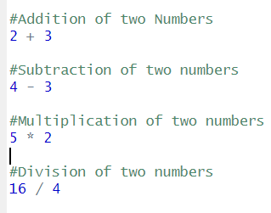
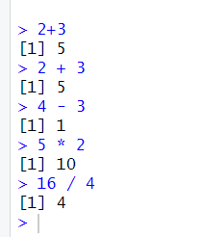
Getting started with R
R script
Corresponding console Pane for the script

Slide 15


Entering Input
At the R prompt we type expression. The symbol <- is the assignment operator
The grammar of the language determines whether an expression is complete or not
The character # indicates comment. Anything to the right of #(including # itself) is ignored

Slide 16
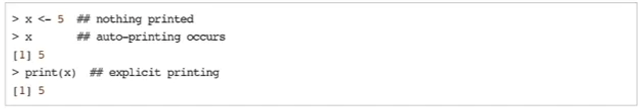
Evaluation
When complete expression is entered at the prompt, it is evaluated and result of evaluated expression is returned.

Slide 17
How is R script better than console?
Scalability : R scripts are more suitable for large projects
Reusability: Can be used across different projects and be shared easily
Documentation and clarity: Easier to understand logic of code
Consistency: Running an entire script ensures that the code is executed in a consistent environment each time, which is crucial for reproducibility.

Slide 18

Working with Directory in R
If we want to reset the working directory to another location as per the user’s preference then that as well can be done in the following way
Before writing a program or code using R, it is important to find out the directory being used.
You can again verify using the command given below

